Slide 1
SAP Cloud Application Programming Model

Slide 2
Overview of CAPM

Slide 3
What is CAPM ?
Cloud Application Programming Model (CAPM)
SAP’s framework for building cloud-native enterprise apps and services on SAP BTP.

Slide 4
Why do we need CAP ?
Traditional enterprise development takes time because we repeatedly build:
database layer
service layer
authentication
validation
OData exposure
deployment config
CAP gives these out of the box.

Slide 5
Key Features
Model – driven development
Service-oriented
Cloud native
Open standards
Multiple runtimes

Slide 6
Best use cases of CAP
Supplier portal
Approval workflows
Procurement cockpit
Vendor onboarding
API orchestration layer
S4 extensions
Side-by-side apps

Slide 7
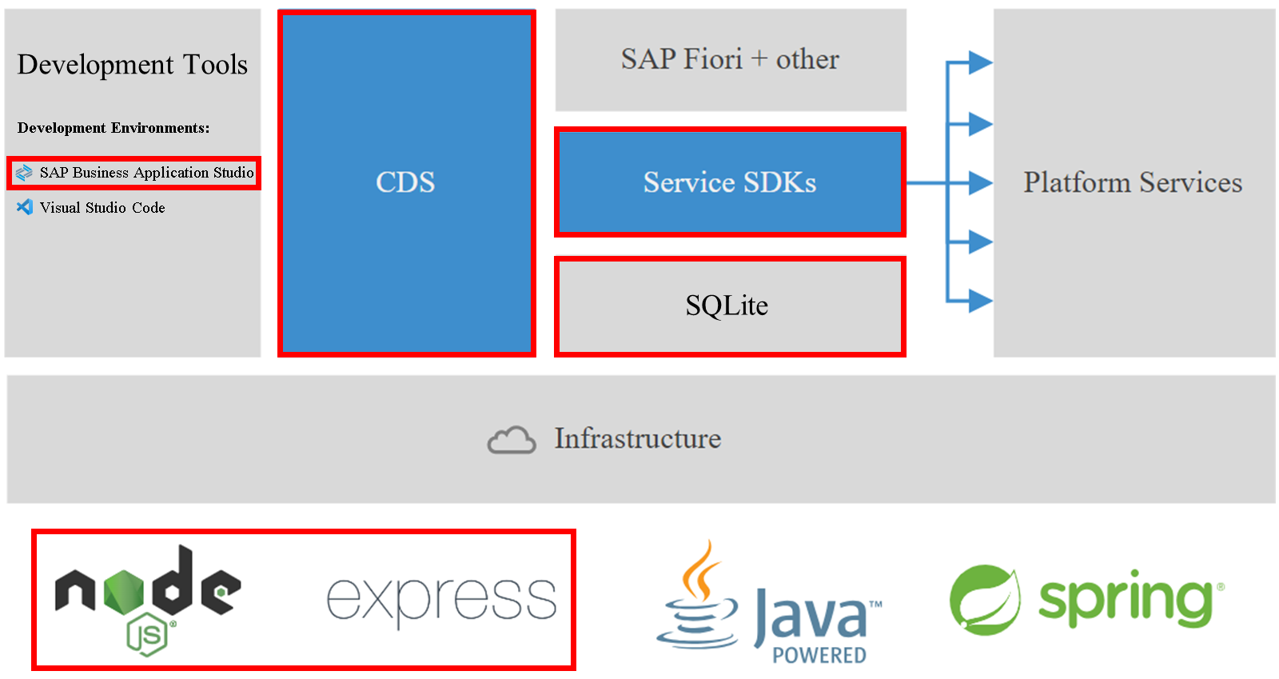
CAP Infrastructure

Slide 8
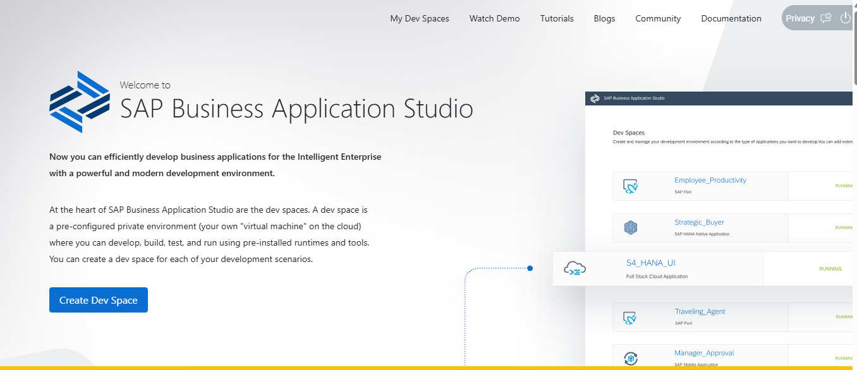
BAS (Business Application Studio)
Browser based development environment
Private Virtual Machine in Cloud
VS Code Compatible Experience
Optimized for :
SAP UI5
Fiori
CAP
SAP BTP Development

Slide 9
DEV Spaces
SAP Fiori Dev Space
Full Stack Cloud Application Dev Space
Full Stack Application Using Productivity Tools
SAP HANA Native Application
SAP Mobile Application Dev Space
Full Stack ABAP Application Dev Space

Slide 10
Creation of the first project
app
db
srv
packagse.json

Slide 11
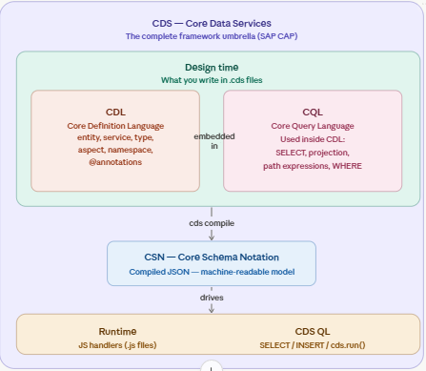
CDS Umbrella
CDS (umbrella concept)
│
├── CDL → model definition language (.cds files)
│ → entities, services, annotations
│
├── CSN → compiled JSON model
│ → machine readable
│
├── CQL → query language
│ → SQL-like query syntax
│
└── cds.ql → JavaScript query builder API
→ creates CQN internally

Slide 12
Domain Models

Slide 13
Service Models

Slide 14
Databases

Slide 15
Advanced Domain Modeling
Associations
To – One Association
To – Many Association
Compositions
To – One Association
To – Many Association
Aspects
Extend

